Slide 1


Nuclear Power Plant Decommissioning
Matthew Hill
Binam Kayastha
Connor Reardon
Justin Mancovsky
Notes:
There are currently 100 licensed nuclear power plants operational in the US. There are 26 that are scheduled to be decommissioned or already have been. Nuclear power plants have a specific life spans. Life spans can be reduced by reactor malfunctions (to to human error or old technology) and meeting new regulations.

Slide 2
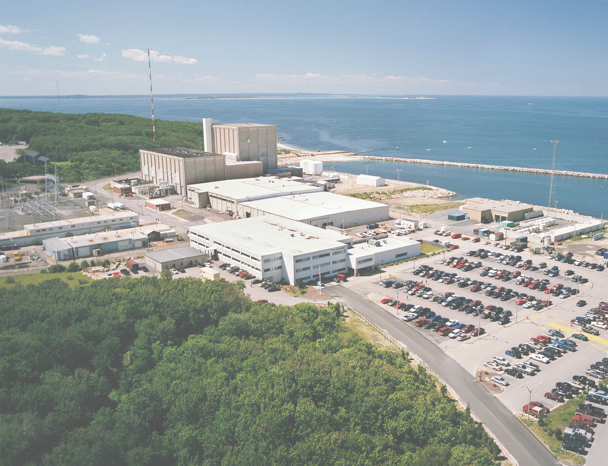
Host communities of decommissioned nuclear power plants face serious
socio-economic issues.
To improve outcomes for host communities of nuclear power plants.
Notes:
Problem Statement: Host communities of decommissioned nuclear reactors face serious socioeconomic issues, with limited or no support to help fight the problems that arise.
Project Goal: To provide support to host communities of nuclear power plants by discovering lessons learned from past decommissionings and creating best practices to mitigate the socioeconomic implications.

Slide 3


Conservation Law Foundation
Protect the communities and environments of New England for the benefit of all
Responsible for cleanup of Boston Harbor, Georges Bank, and Lake Champlain
Composed primarily of lawyers and environmental activists
“We never give up and go home because we are home”
Notes:
The CLF values the safety and the sustainability of New England area
CLF protects New England’s environment for the benefit of all people. We use the law, science and the market to create solutions that preserve our natural resources, build healthy communities, and sustain a vibrant economy.

Slide 4
Safety & Environmental
Legal
Socio-economic Impacts from Nuclear Power Plant Decommissioning
Economic
Other
Social

Slide 5
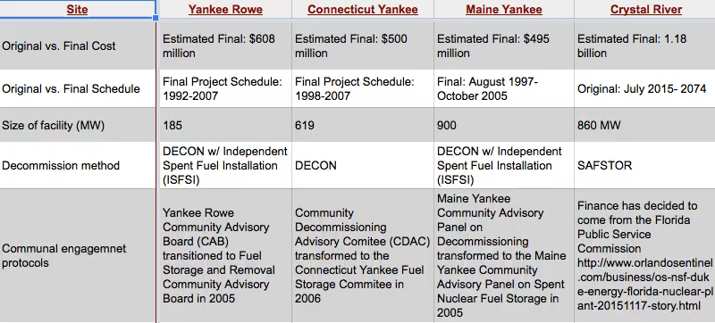
Deliverables: Matrix

Slide 6
Deliverables: “Road Map” for Plymouth, MA
Decommission planned to begin in 2019
Information gathered from our project will help us to provide an informative guide to the community

Slide 7
Research Objectives
What is the best way in which we can provide support to communities suffering from the impacts of nuclear power plant decommissioning?
Objective 1: Identify socio-economic impacts from past decommissions
Objective 2: Explore similarities and trends among impacts
Objective 3: Analyze past/current stakeholder engagement and protocols
Objective 4: Explore revitalization practices for future communal use
Notes:
Obj 3: this means that we will need to understand the what worked and didn't work in the past (via interviews) and what engagement the current stakeholders have (via focus groups)

Slide 8
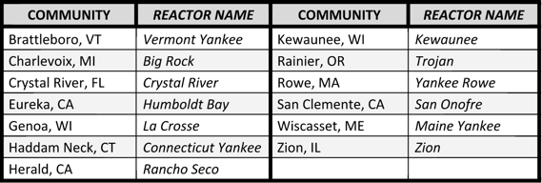
Information Extraction
Performing case studies on nuclear power plant communities
Conducting interviews with community members that were/are directly involved in the process
Forming focus groups with members of the Plymouth community

Slide 9
Limitations
Determining whether socio-economic changes are directly caused by decommissioning
Each community is different; causing it to be hard to generalize solutions
Protecting confidentiality when conducting research

Slide 10

Questions?
Pilgrim Nuclear Power Plant – Plymouth, MA

